Slide 1
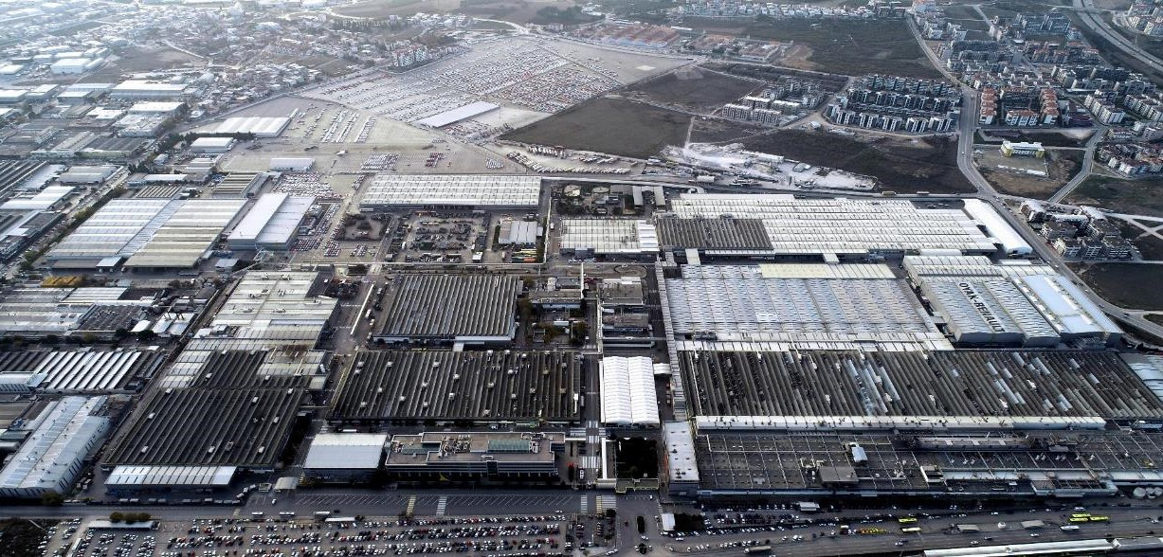
Mobility contest 2023 X Mobilize

Slide 2
RENAULT GROUP
Mobility contest 2023 X Mobilize Link
Prizes
The prizes are awarded to the winners of the Challenge and are subject to compliance with the following cumulative conditions:
The Deliverables comply with Sections 6 and 11;
Each Participant of a winning project complies with Sections 9 and 11;
It can be proven that the winning Participants fulfill the conditions of eligibility of Section 4.
No prize will be awarded to winners who do not fulfill the above conditions.
Subject to these Terms and Conditions, once confirmed by Sponsor, the winner(s) will receive the following:
Grand Prize Category B2C of
a fast-track for Renault Group internship recruitment process to possibly implement your idea to reality,
Invitation to a sports OR cultural event hosted in La Défense Arena within the sponsorship of Mobilize Beyond automotive and La Défense Arena performance hall
A satellite pocket from Peti Pli brand (120 euros)
For a total estimated price of 1000€ per team member
Grand Prize Category B2B of
a fast-track for Renault Group internship recruitment process to possibly implement your idea to reality,
Invitation to a sports OR cultural event hosted in La Défense Arena within the sponsorship of Mobilize Beyond automotive and La Défense Arena performance hall
A satellite pocket from Peti Pli brand (120 euros)
For a total estimated price of 1000€ per team member
Heart Prize of Mobilizers of
A satellite pocket from Peti Pli brand
For a total estimated price of 120€ per team member
Round One 7 March 2023 to 30 April 2023
At the end of this Round, up to 20 winning Teams will be pre-selected to proceed to Round Two.
Round Two 9 May 2023 to 11 June 2023 11:59 PM
At the end of this Round, up to 8 winning Teams will be selected to proceed to the Final Round.
Final Round Participants are not required to upload a Deliverable on the Challenge website for this Final Round.
Criteria based voting
Criteria based” voting will take place from 2nd of May 8:00H AM to 5th of May 12:00H
PM
Relevancy and Impact (25%)
Technical Feasibility (25%)
Business Value (25%)
Environmental & Social Value (25%)

Slide 3
RENAULT GROUP
Choose from 2 categories
Category 1: Emotional services for Duo users (B2C)
This is where we need your help! If you have an idea that has the potential to improve the experience of our consumers while using Duo, then this challenge is just for you!
We want ideas that make Duo a fun, irresistible, and attractive vehicle while making sure it has the best value in upgradability, flexibility and adaptability to keep our consumers more than satisfied and optimize fidelity overtime!
Category 2: Services for Duo and Bento fleet managers (B2B)
Mobilize is also looking to maximize value and create business services to its Duo and Bento fleet managers
Whether parked, stopped, or charging, we need your ideas to make the most of our vehicles and increase efficient professional usage
If you have a solution that could increase the value of our parked or stopped vehicles and create indirect business value, then go ahead and apply! Your idea could soon become a reality!

Slide 4
Thank you!

